Slide 1
Lecture 13 : BCSE302L – DBMS
indexing

Slide 2
Indexing
Dense Indexing – If an entry is created fro every search Key Value
Sparse Indexing – If an index entry is created for some records

Slide 3
Types of Single-Level Indexes
Types of Single-level Ordered Indexes
Primary Indexes –(Primary Key + Ordered)
Clustering Indexes - (Non Key +Ordered)
Secondary Indexes - (Non Key |Candidate Key = Unordered)
Multilevel Indexes
Dynamic Multilevel Indexes Using B-Trees and B+-Trees

Slide 4
Primary Index
Defined on an ordered data file
The data file is ordered on a key field
Includes one index entry for each block in the data file; the index entry has the key field value for the first record in the block, which is called the block anchor
A similar scheme can use the last record in a block.
A primary index is a nondense (sparse) index, since it includes an entry for each disk block of the data file and the keys of its anchor record rather than for every search value.

Slide 5
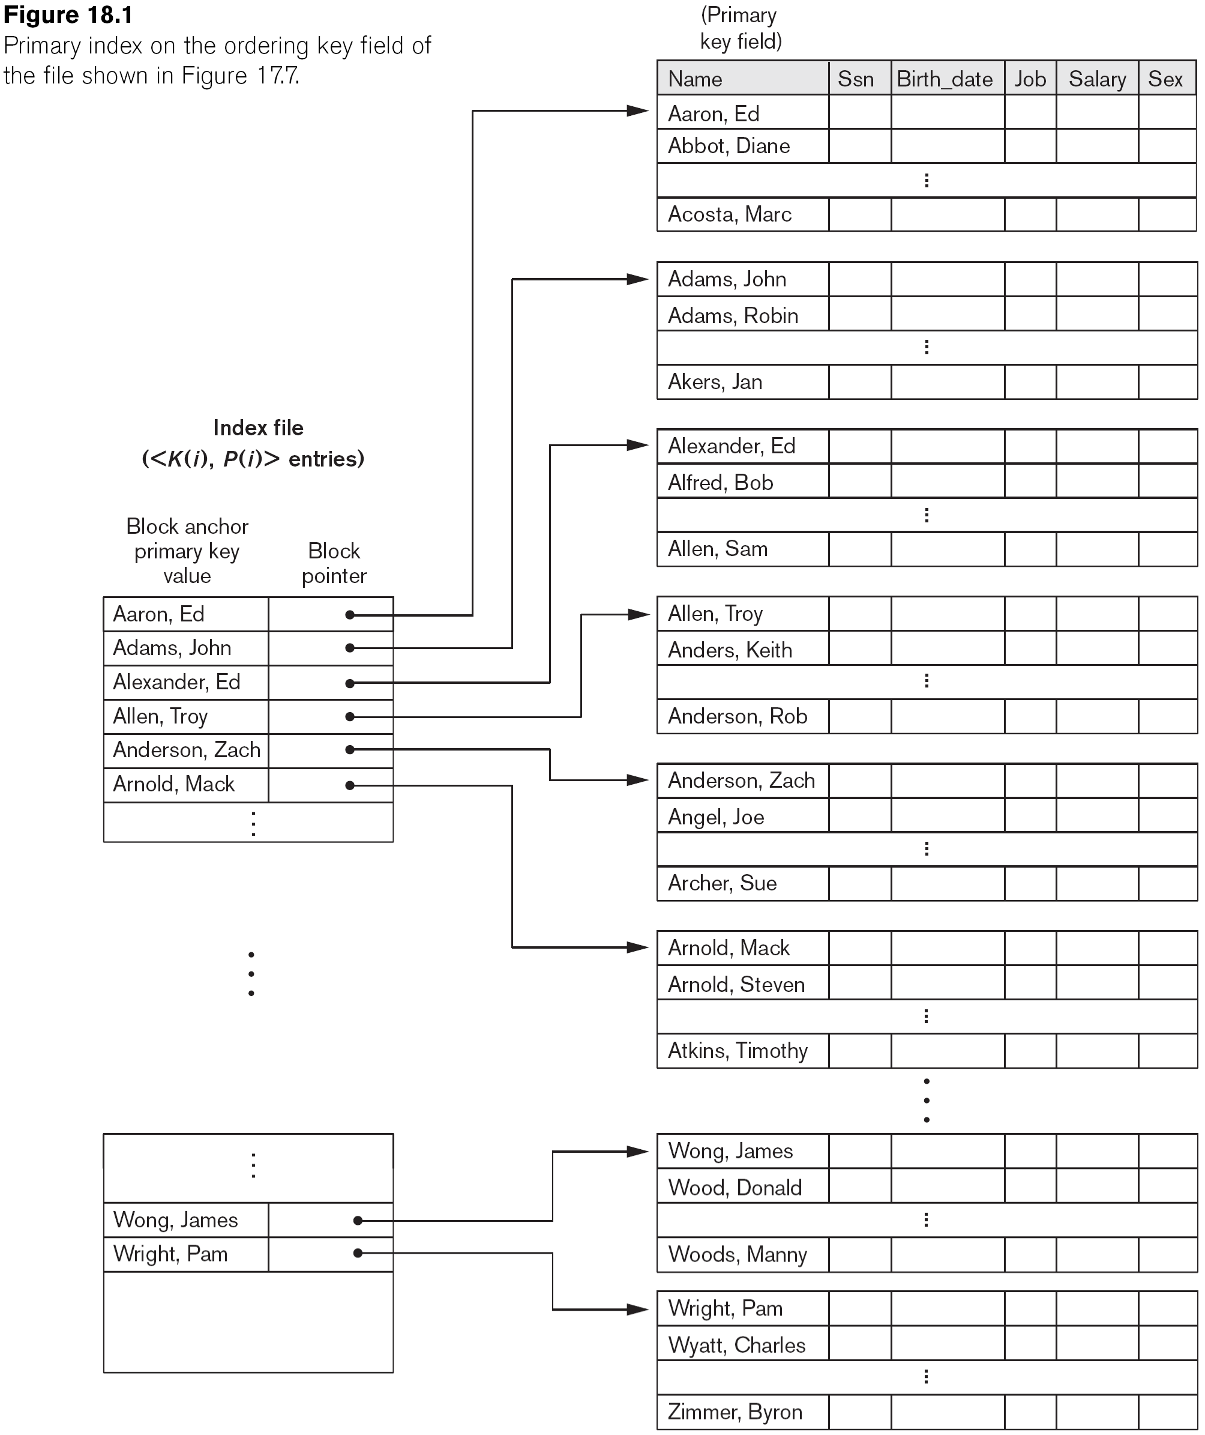
Primary Index on the Ordering Key Field

Slide 6
Clustering Index
Defined on an ordered data file
The data file is ordered on a non-key field unlike primary index, which requires that the ordering field of the data file have a distinct value for each record.
Includes one index entry for each distinct value of the field; the index entry points to the first data block that contains records with that field value.
It is another example of nondense index where Insertion and Deletion is relatively straightforward with a clustering index.

Slide 7
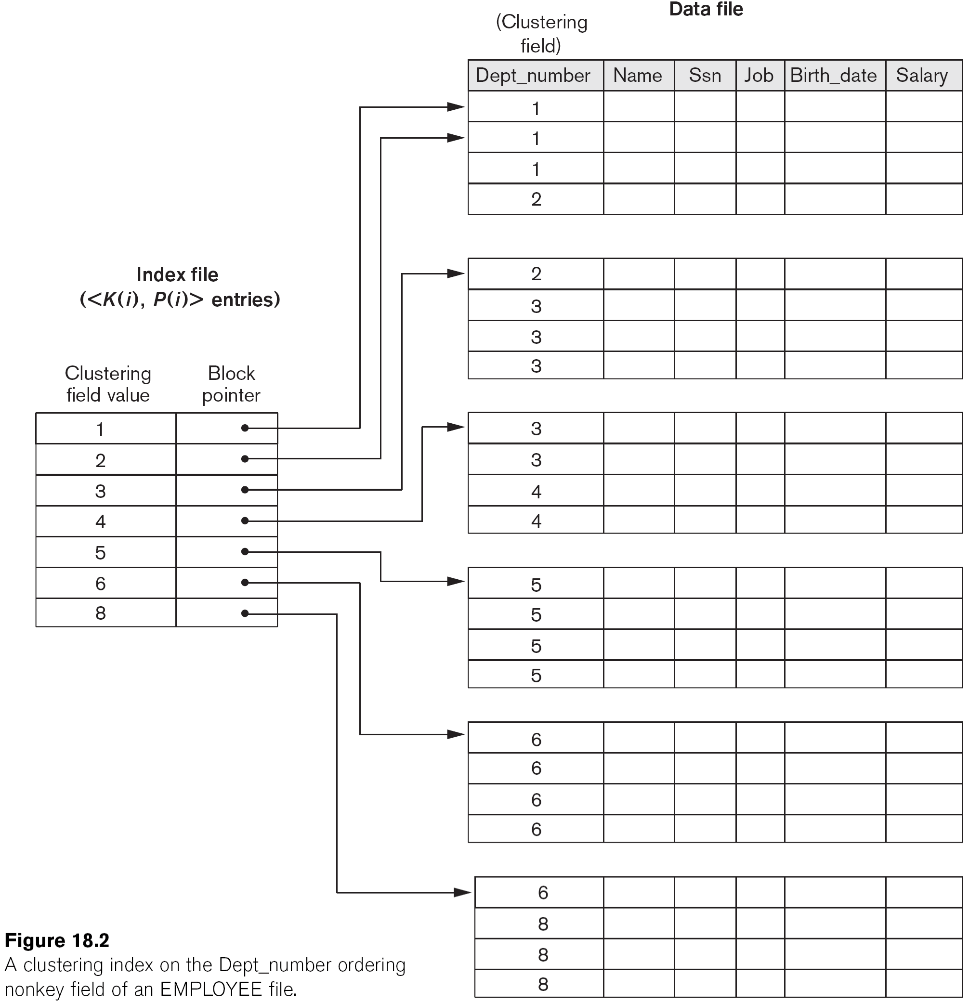
A Clustering Index Example

Slide 8
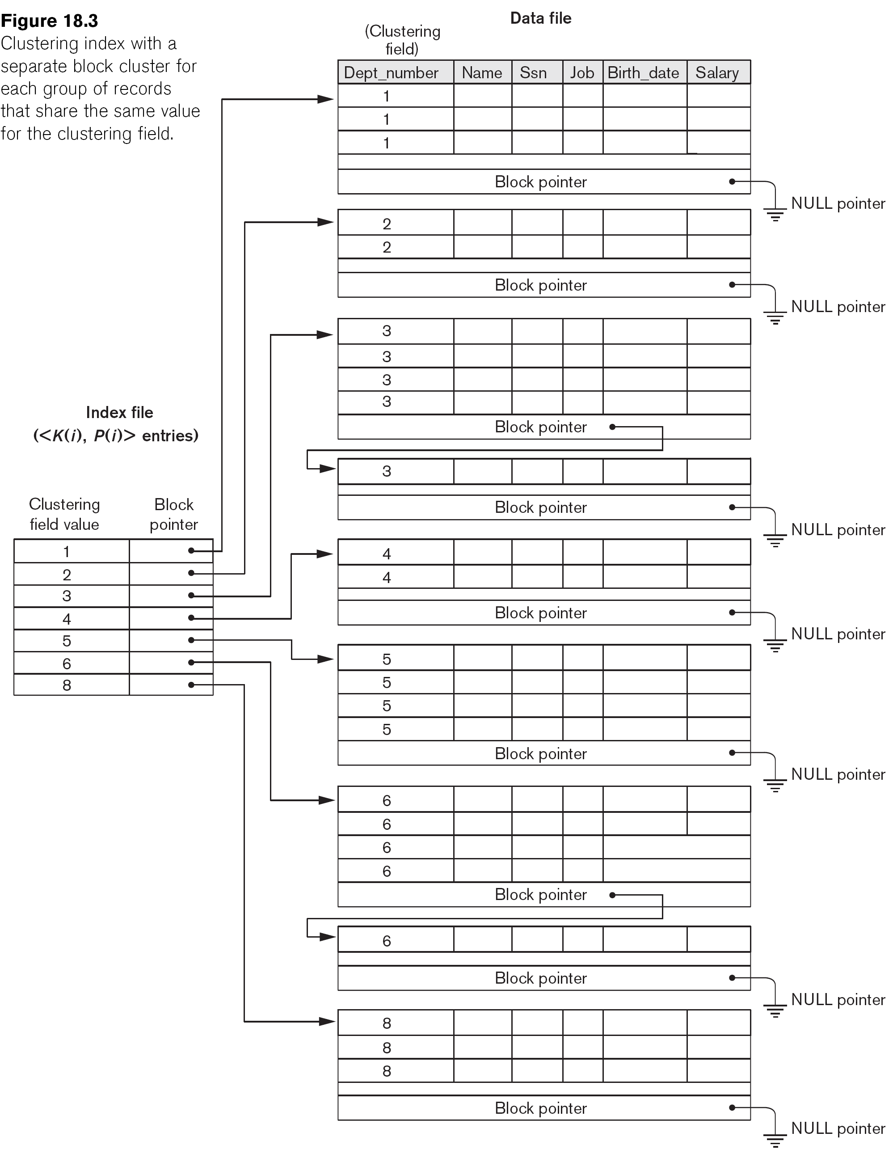
Another Clustering Index Example

Slide 9
Secondary Index
A secondary index provides a secondary means of accessing a file for which some primary access already exists.
The secondary index may be on a field which is a candidate key and has a unique value in every record, or a non-key with duplicate values.
The index is an ordered file with two fields.
The first field is of the same data type as some non-ordering field of the data file that is an indexing field.
The second field is either a block pointer or a record pointer.
There can be many secondary indexes (and hence, indexing fields) for the same file.
Includes one entry for each record in the data file; hence, it is a dense index

Slide 10
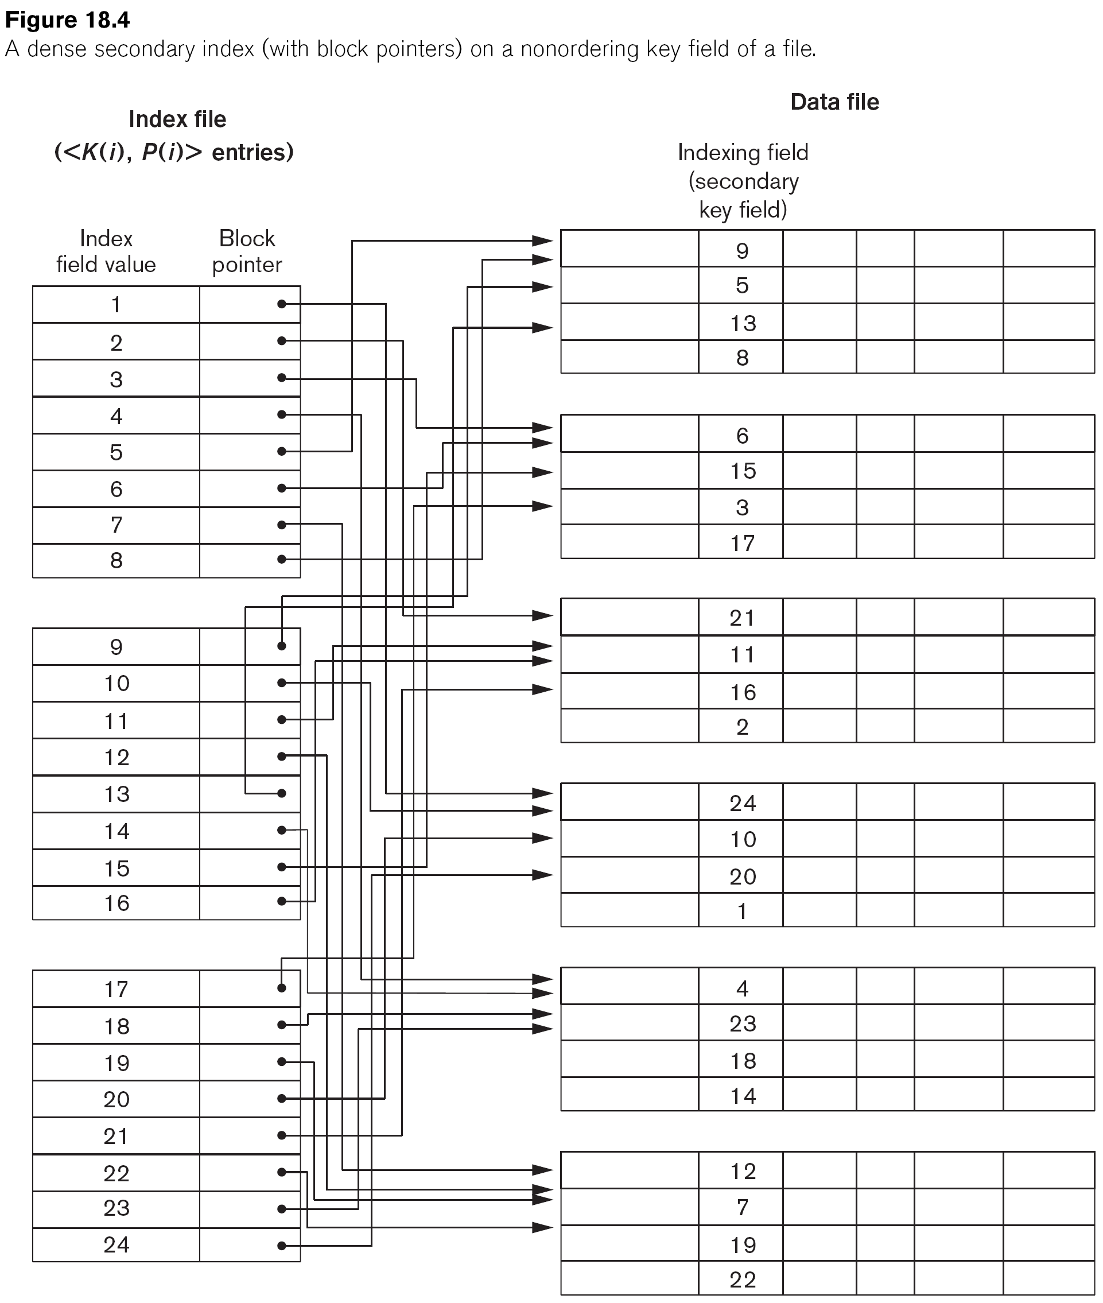
Example of a Dense Secondary Index

Slide 11
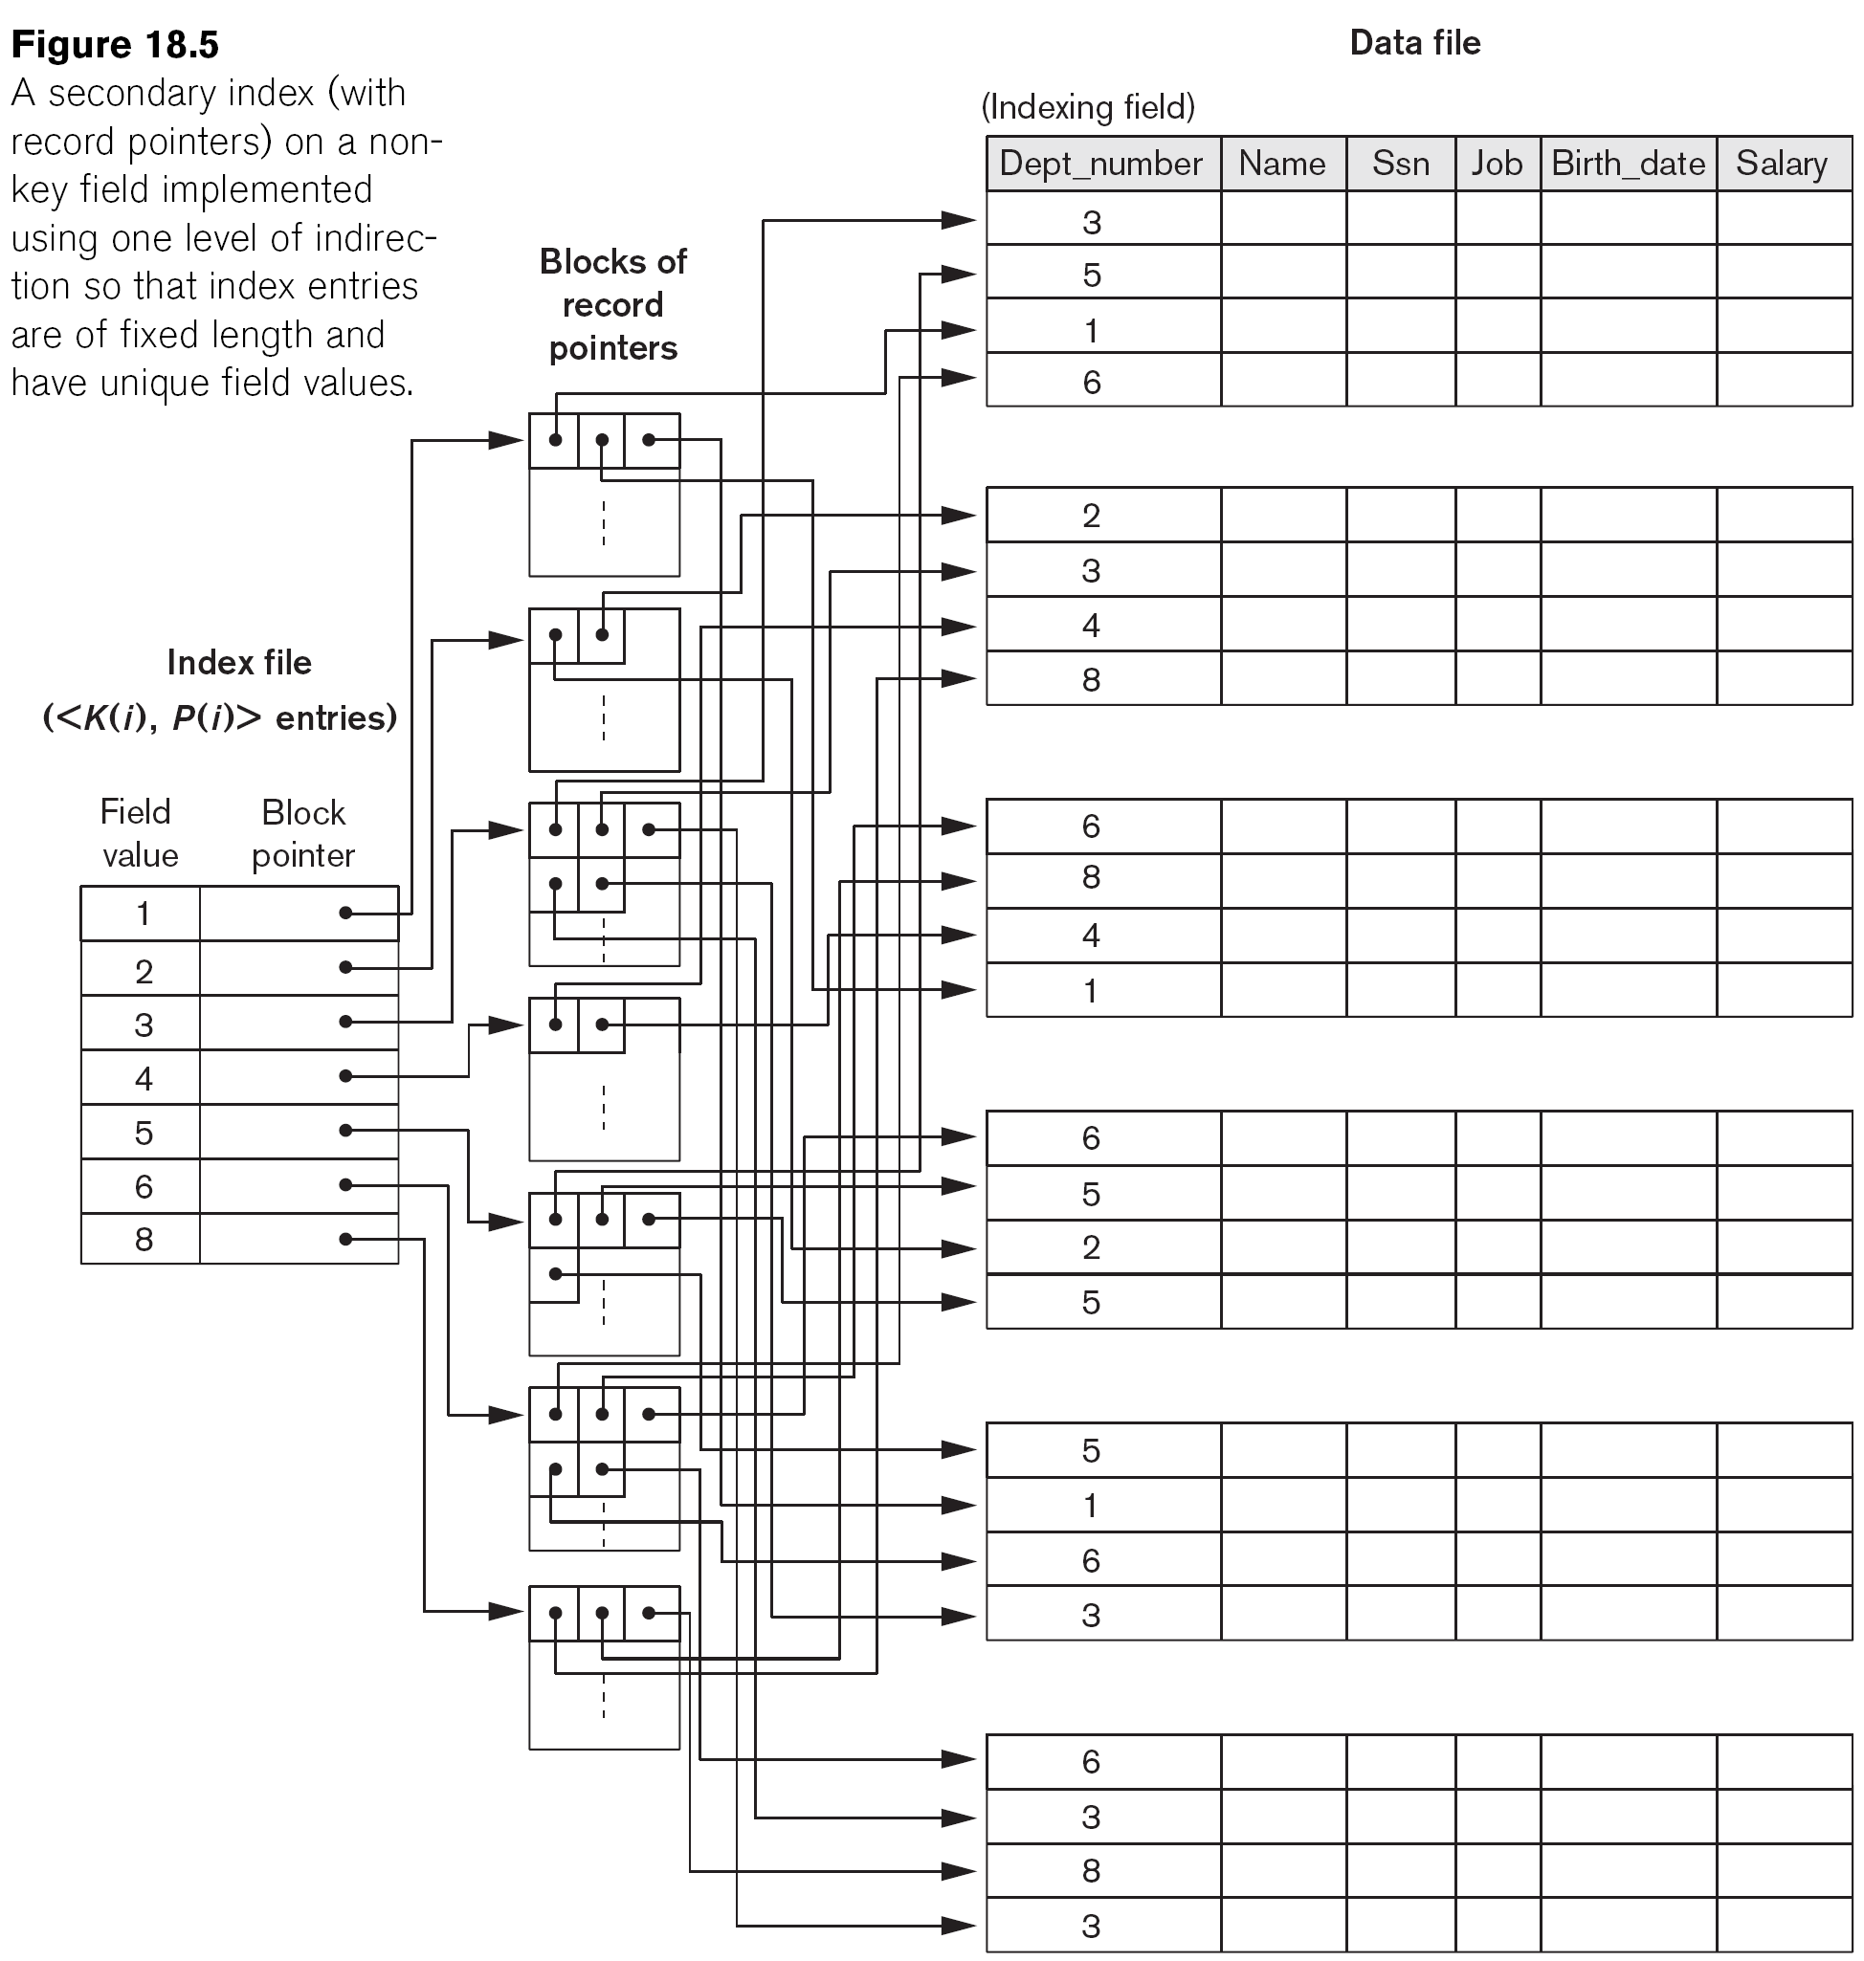
Example of a Secondary Index

Slide 12
Multi-Level Indexes
Because a single-level index is an ordered file, we can create a primary index to the index itself;
In this case, the original index file is called the first-level index and the index to the index is called the second-level index.
We can repeat the process, creating a third, fourth, ..., top level until all entries of the top level fit in one disk block
A multi-level index can be created for any type of first- level index (primary, secondary, clustering) as long as the first-level index consists of more than one disk block

Slide 13
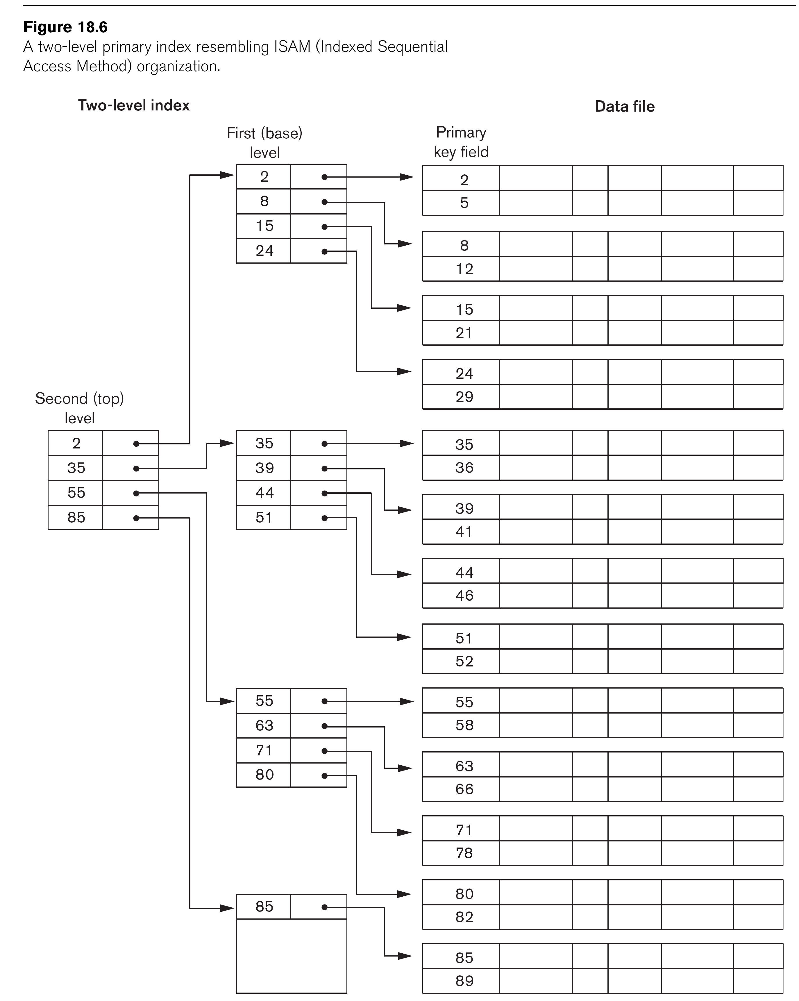
A Two-Level Primary Index

Slide 14
Multi-Level Indexes
Such a multi-level index is a form of search tree
However, insertion and deletion of new index entries is a severe problem because every level of the index is an ordered file.

Slide 15
Dynamic Multilevel Indexes Using B- Trees and B+-Trees
Most multi-level indexes use B-tree or B+-tree data structures because of the insertion and deletion problem
This leaves space in each tree node (disk block) to allow for new index entries
These data structures are variations of search trees that allow efficient insertion and deletion of new search values.
In B-Tree and B+-Tree data structures, each node corresponds to a disk block
Each node is kept between half-full and completely full

Slide 16
Dynamic Multilevel Indexes Using B- Trees and B+-Trees (cont.)
An insertion into a node that is not full is quite efficient
If a node is full the insertion causes a split into two nodes
Splitting may propagate to other tree levels
A deletion is quite efficient if a node does not become less than half full
If a deletion causes a node to become less than half full, it must be merged with neighboring nodes

Slide 17
Difference between B-tree and B+-tree
In a B-tree, pointers to data records exist at all levels of the tree
In a B+-tree, all pointers to data records exists at the leaf-level nodes
A B+-tree can have less levels (or higher capacity of search values) than the corresponding B-tree

Slide 18
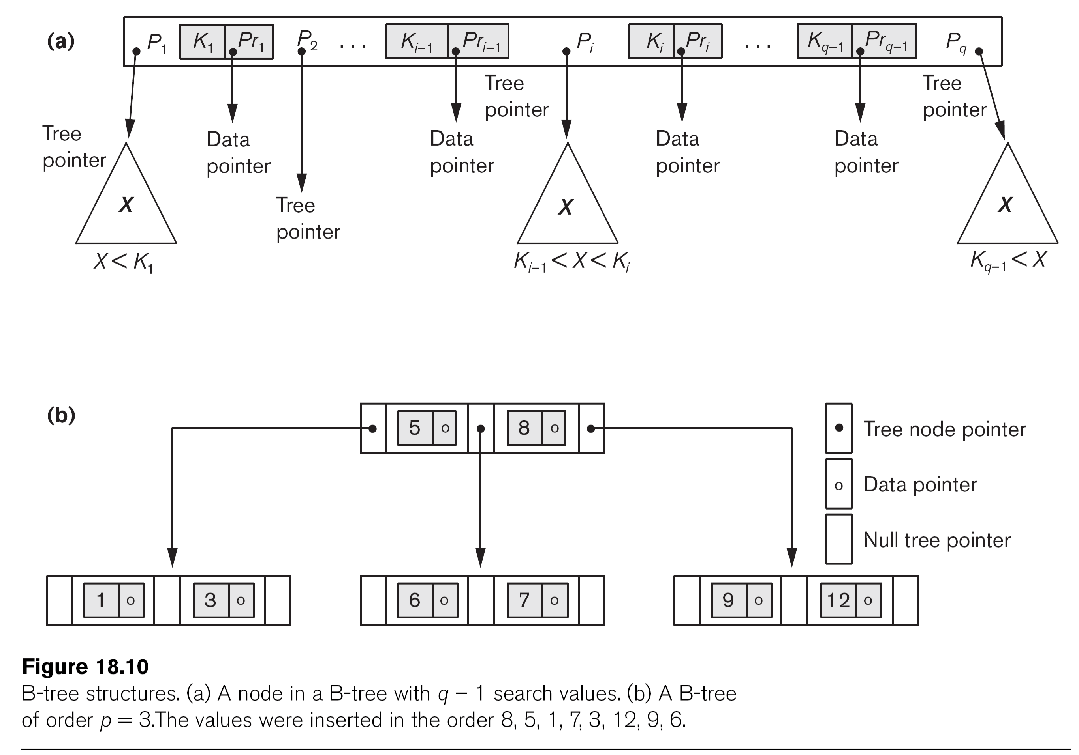
B-tree Structures

Slide 19
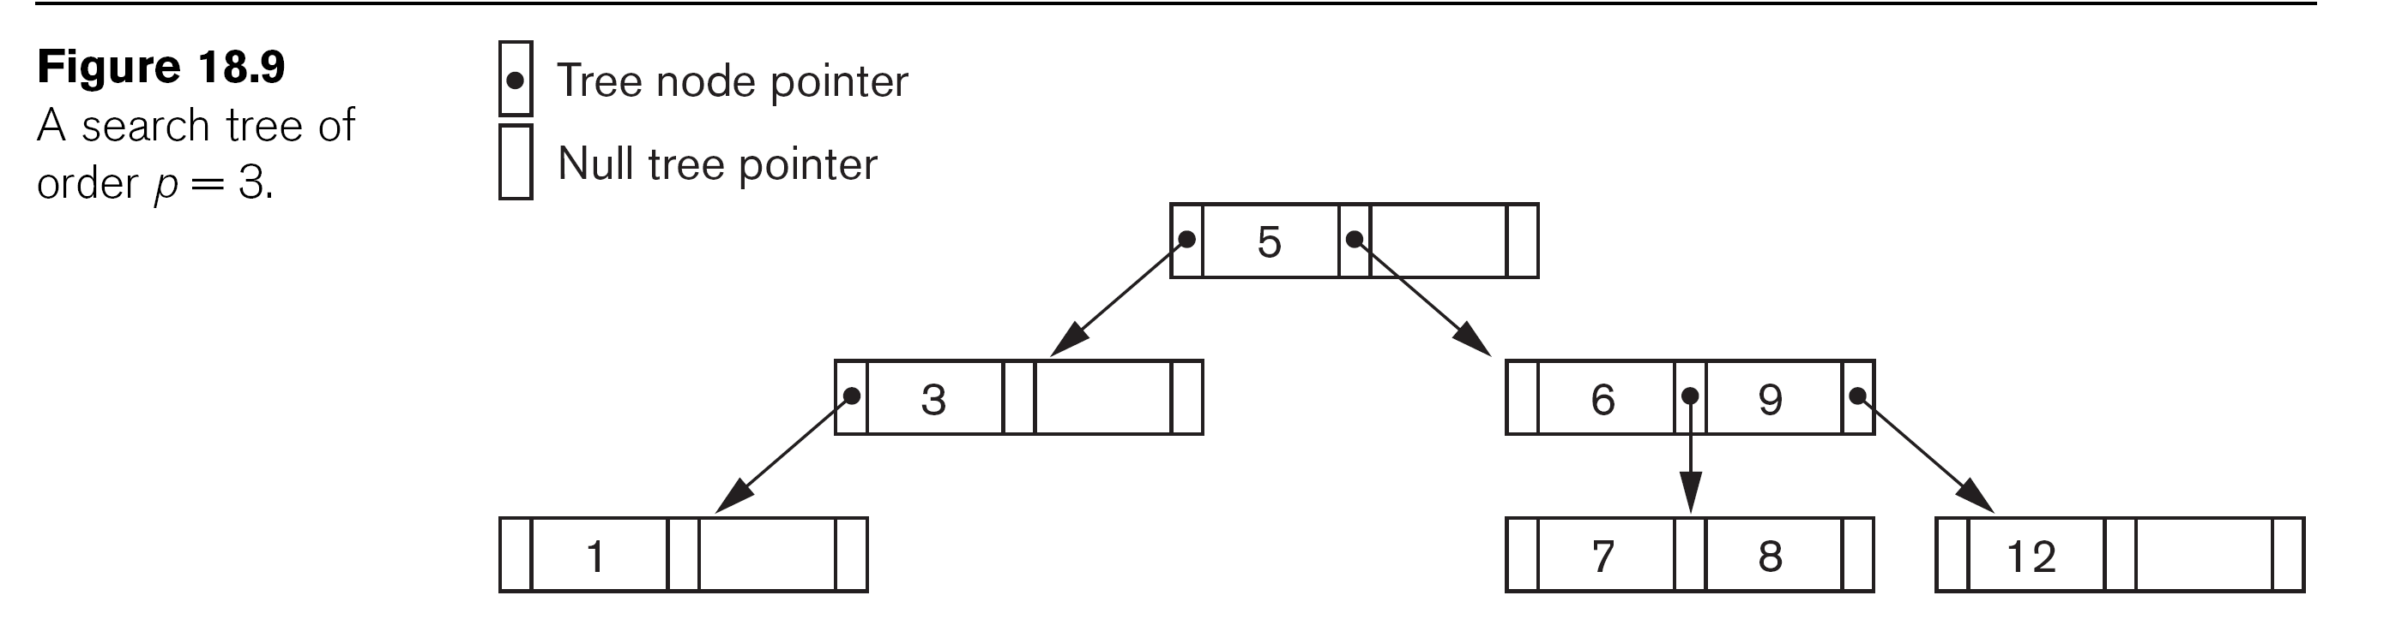

Slide 20
Insertion Operation
If the tree is empty, allocate a root node and insert the key.
Update the allowed number of keys in the node.
Search the appropriate node for insertion.
If the node is not full, follow the steps below.
Insert the node in increasing order.
If the node is full, follow the steps below.
Insert the elements in increasing order.
Now, there are elements greater than its limit. So, split at the median.
Push the median key upwards and make the left keys as a left child and the right keys as a right child.

Slide 21
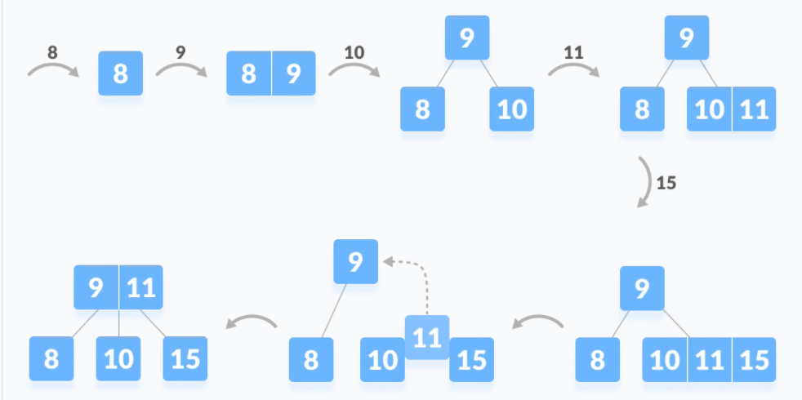
Another Example
The elements to be inserted are 8, 9, 10, 11, 15, 17, 20.

Slide 22
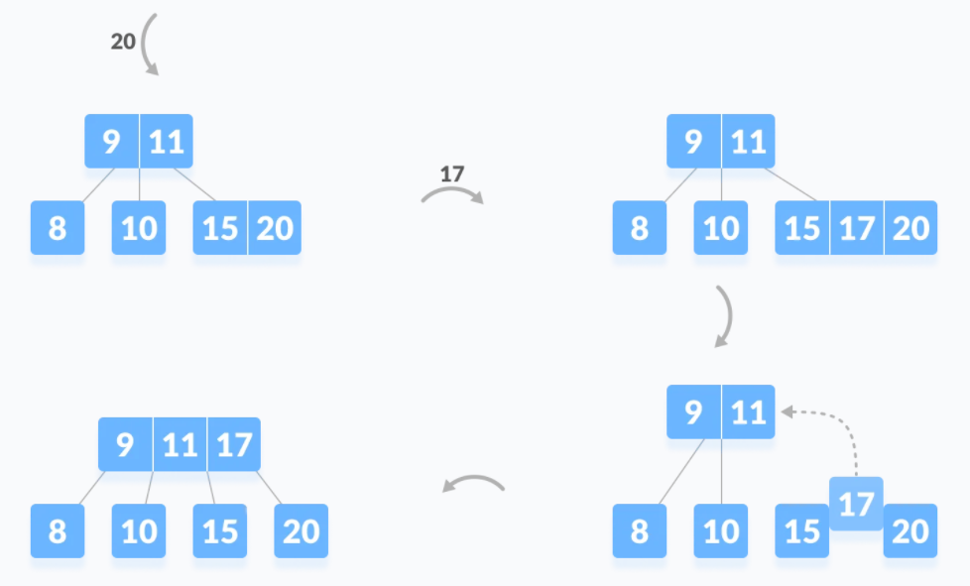
Another Example
The elements to be inserted are 8, 9, 10, 11, 15, 17, 20.

Slide 23
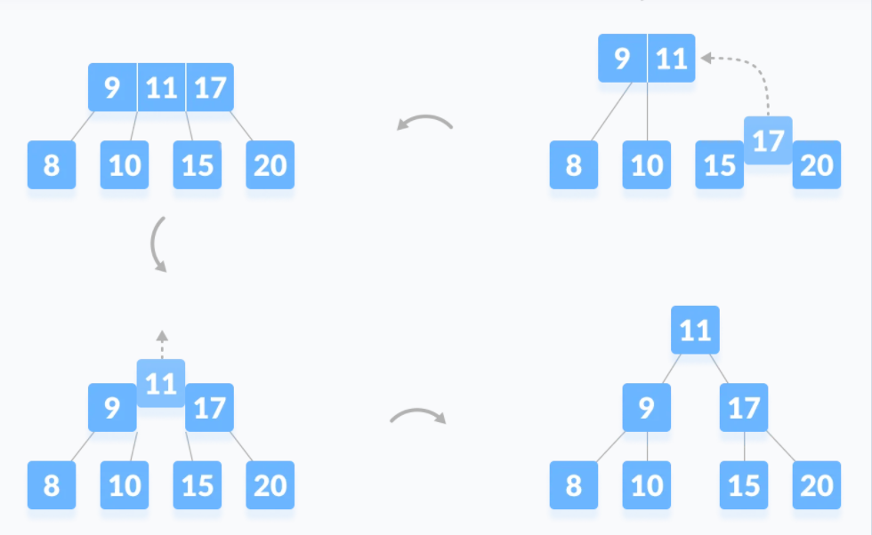
Another Example
The elements to be inserted are 8, 9, 10, 11, 15, 17, 20.

Slide 24
Deletion Operation
Before going through the steps below, one must know these facts about a B tree of degree m.
A node can have a maximum of m children. (i.e. 3)
A node can contain a maximum of m - 1 keys. (i.e. 2)
A node should have a minimum of ⌈m/2⌉ children. (i.e. 2)
A node (except root node) should contain a minimum of ⌈m/2⌉ - 1 keys. (i.e. 1)

Slide 25
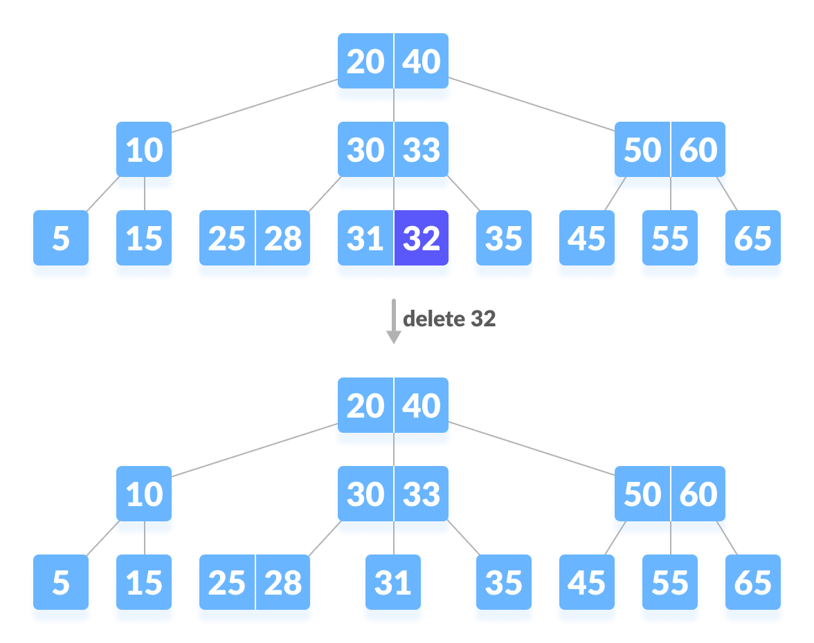
Deletion at leaf node

Slide 26
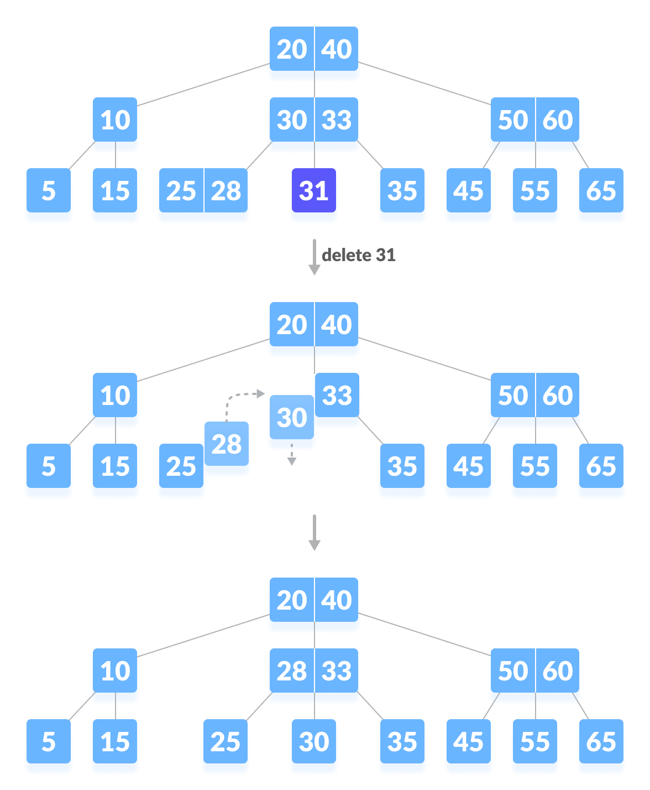
Delete 31

Slide 27
Delete 31

Slide 28
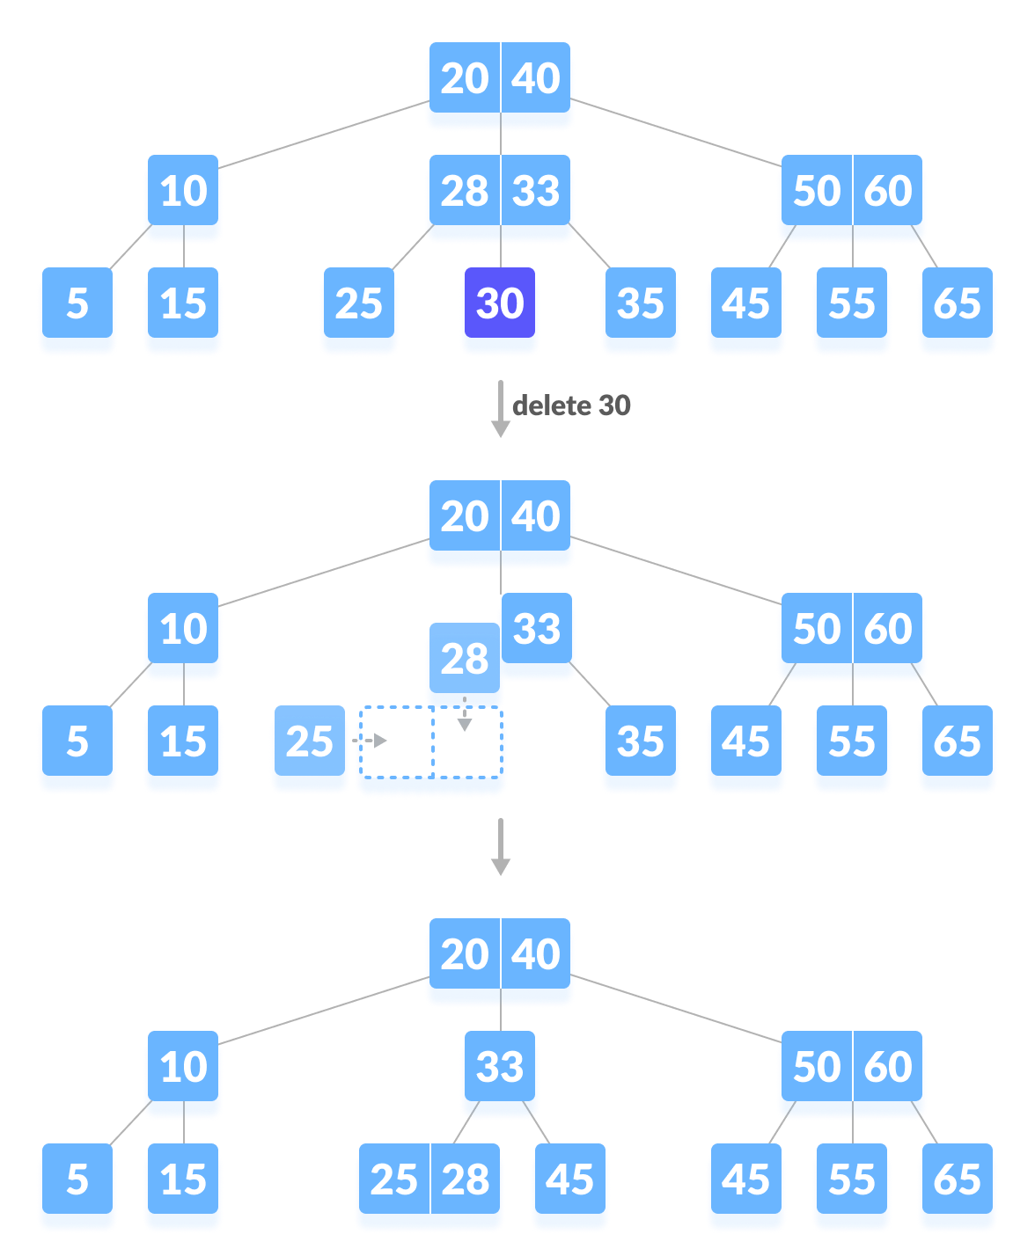
Delete 30

Slide 29
Delete 30

Slide 30
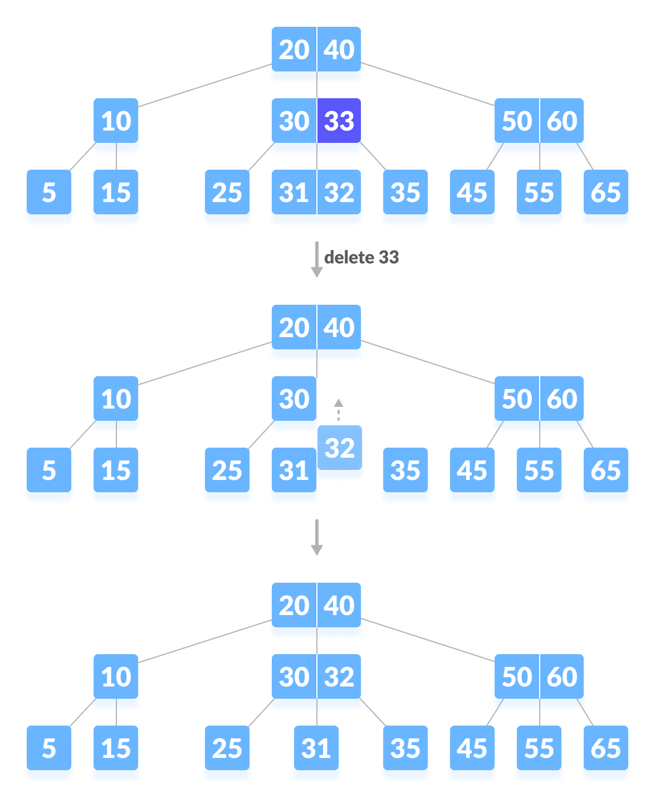
Deleting internal node

Slide 31
Deleting internal node

Slide 32
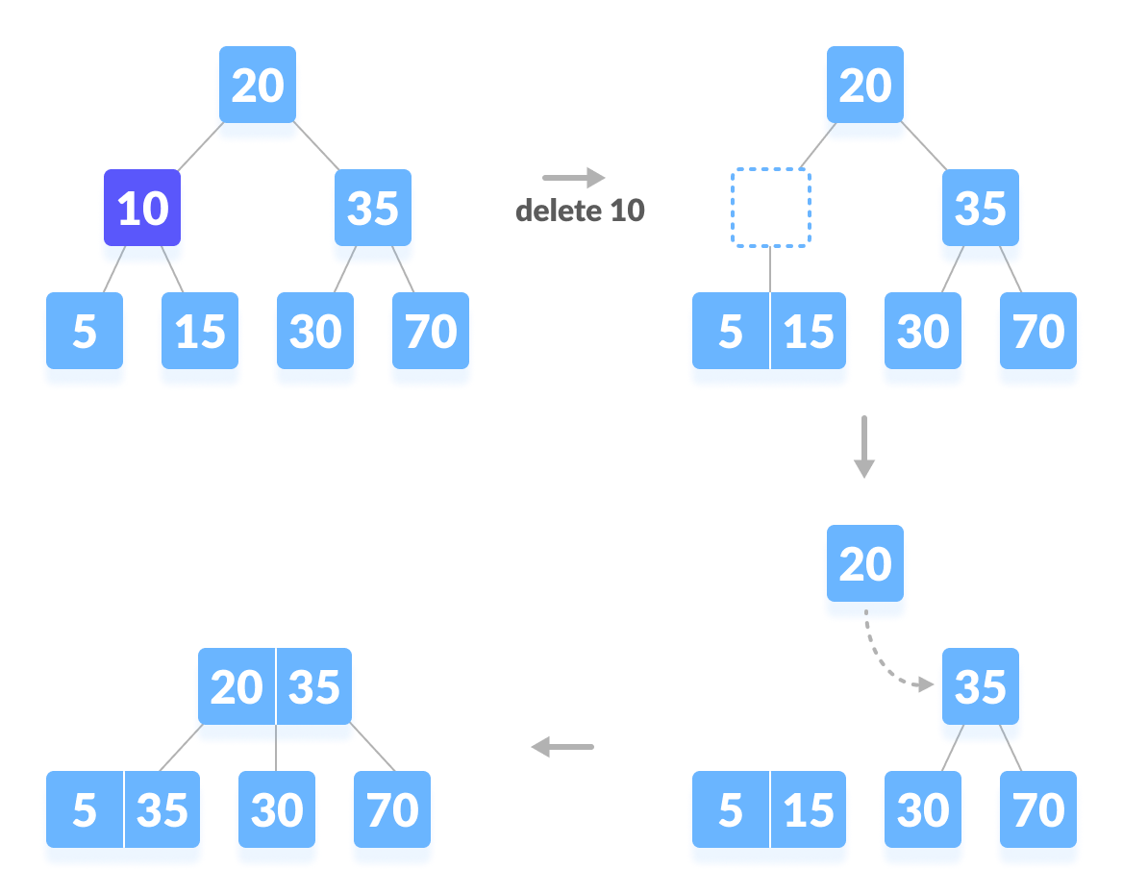
Deleting internal node

Slide 33
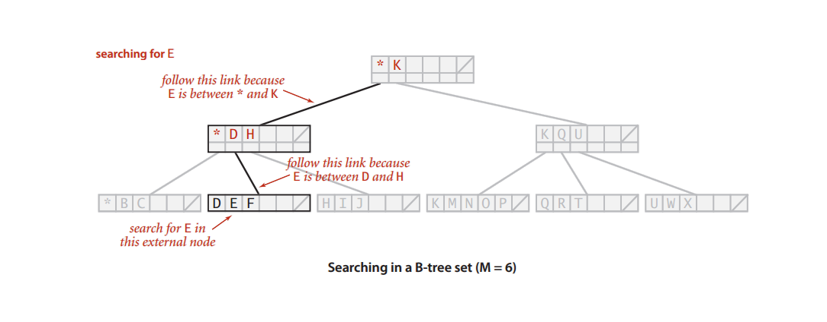
Searching of E

Slide 34
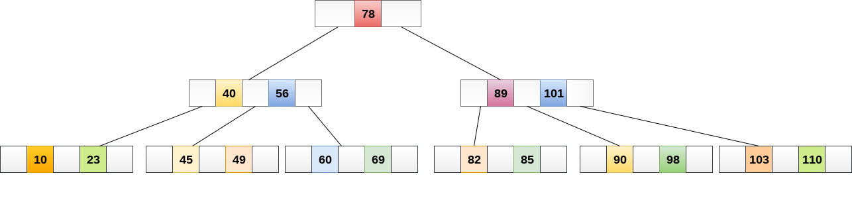
Searching of 49
Compare item 49 with root node 78. since 49 < 78 hence, move to its left sub-tree.
Since, 40<49<56, traverse right sub-tree of 40.
49>45, move to right. Compare 49.
match found, return.

Slide 35
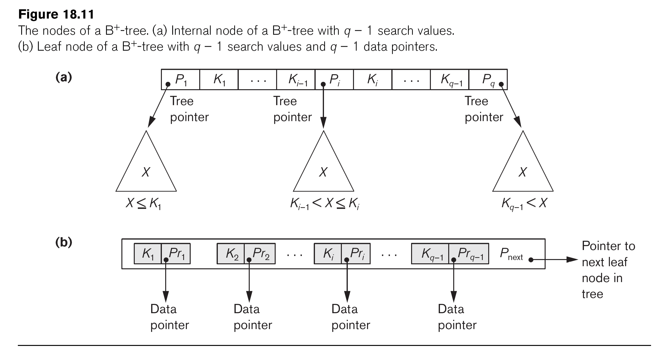
The Nodes of a B+-tree

Slide 36
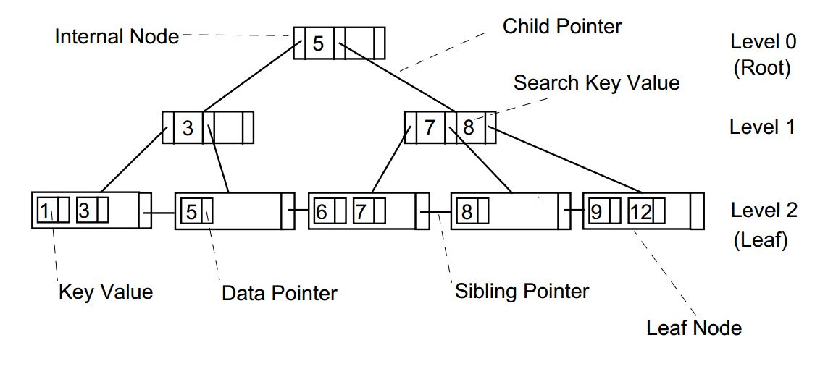
B + Tree

Slide 37
Properties of a B+ Tree
All leaves are at the same level.
The root has at least two children.
Each node except root can have a maximum of m children and at least m/2 children.
Each node can contain a maximum of m - 1 keys and a minimum of ⌈m/2⌉ - 1 keys.

Slide 38
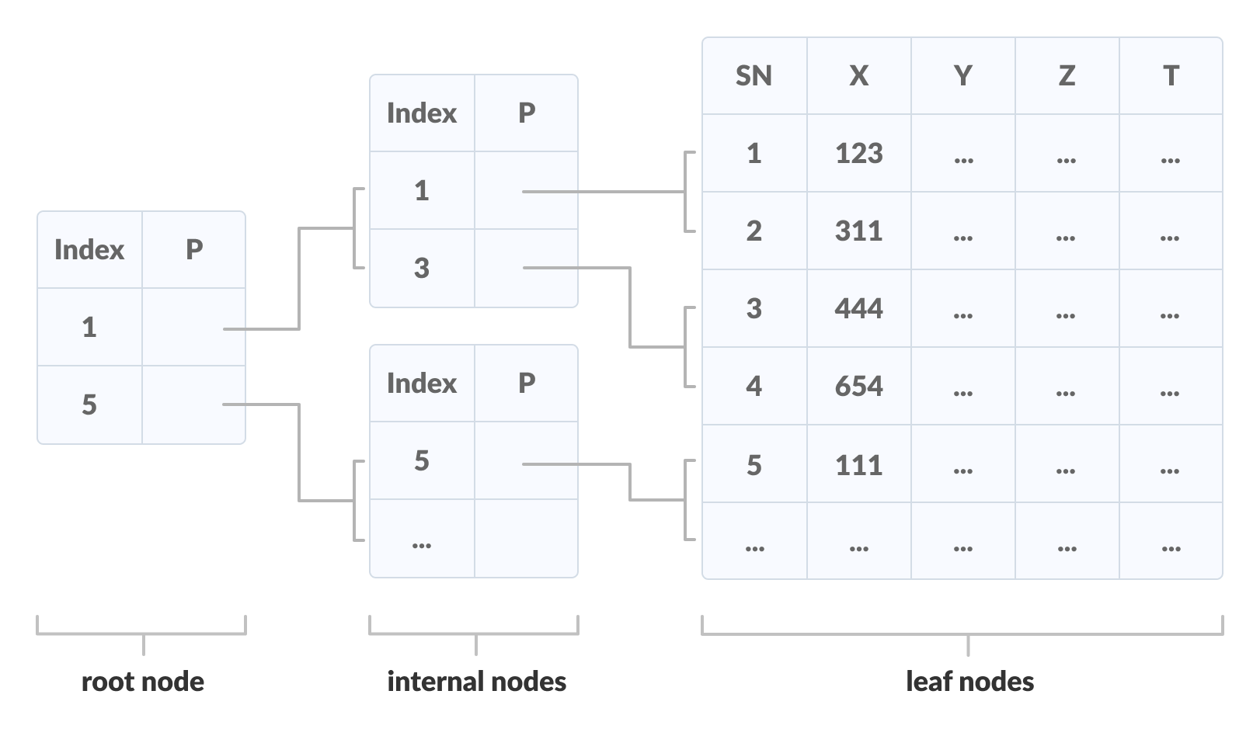

Slide 39
Searching a node in a B+ Tree
The following steps are followed to search for data in a B+ Tree of order m. Let the data to be searched be k.
Start from the root node. Compare k with the keys at the root node [k1, k2, k3,......km - 1].
If k < k1, go to the left child of the root node.
Else if k == k1, compare k2. If k < k2, k lies between k1 and k2. So, search in the left child of k2.
If k > k2, go for k3, k4,...km-1 as in steps 2 and 3.
Repeat the above steps until a leaf node is reached.
If k exists in the leaf node, return true else return false.

Slide 40
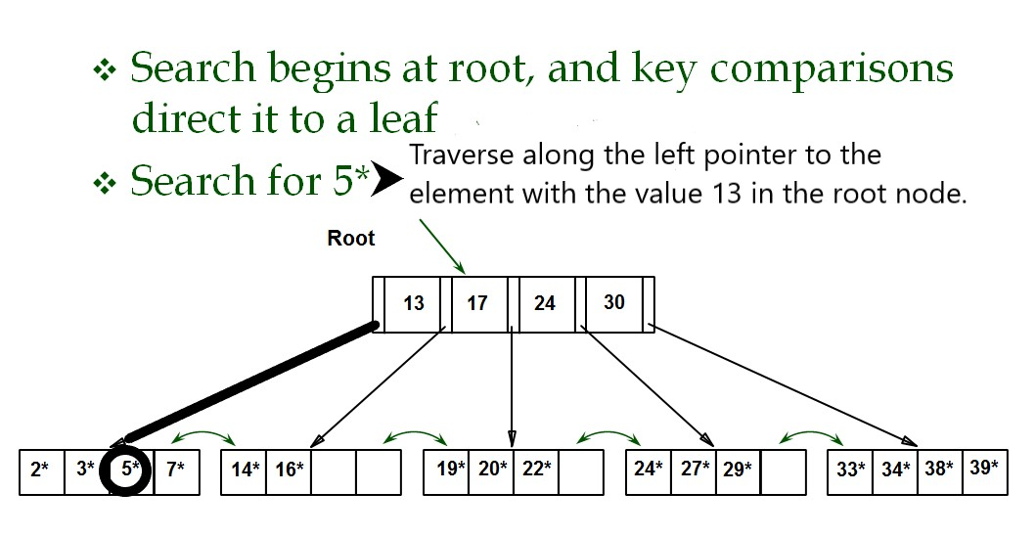

Slide 41
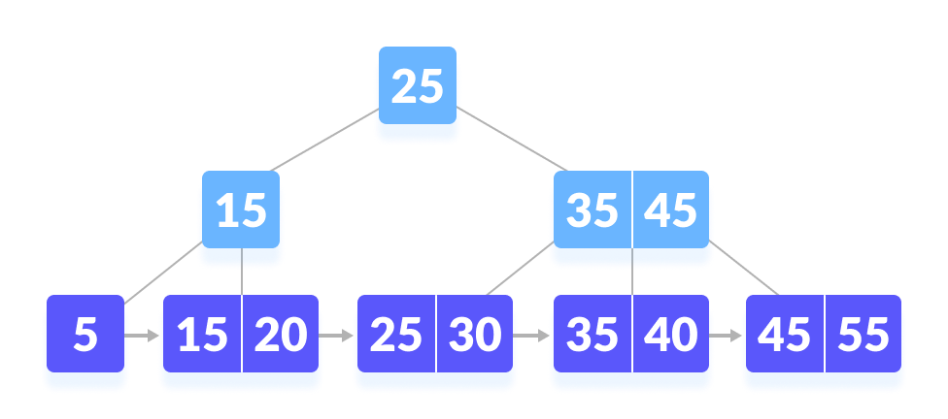
Let us search k = 45 on the following B+ tree.

Slide 42
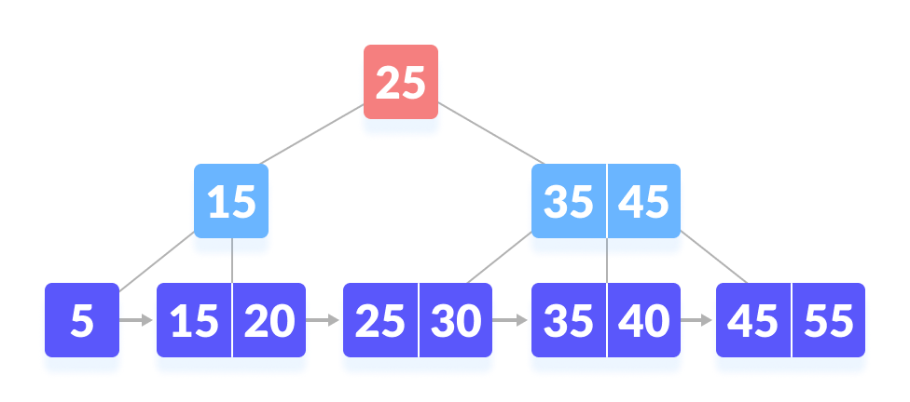
Compare k with the root node.

Slide 43
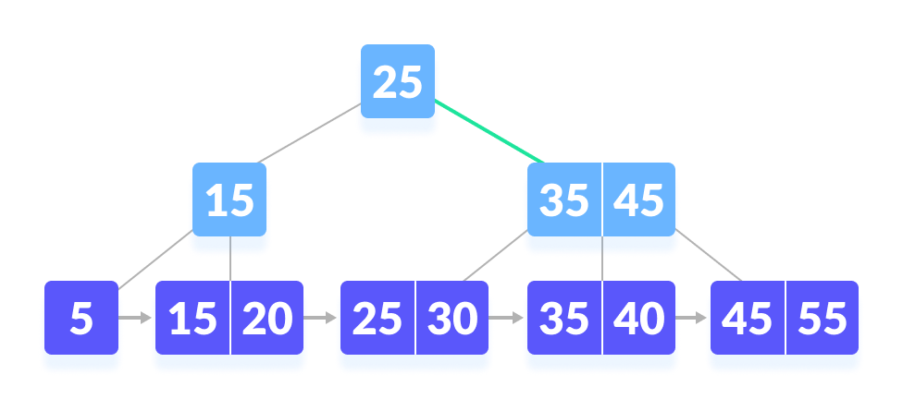
Since k > 25, go to the right child
Go to right of the root

Slide 44
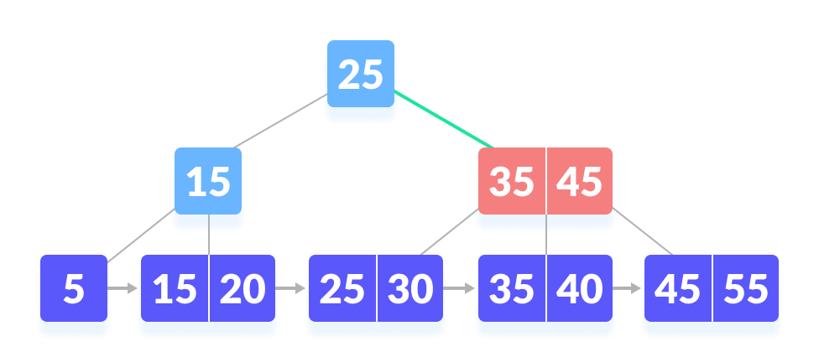
Compare k with 35. Since k > 30, compare k with 45.
k not found

Slide 45
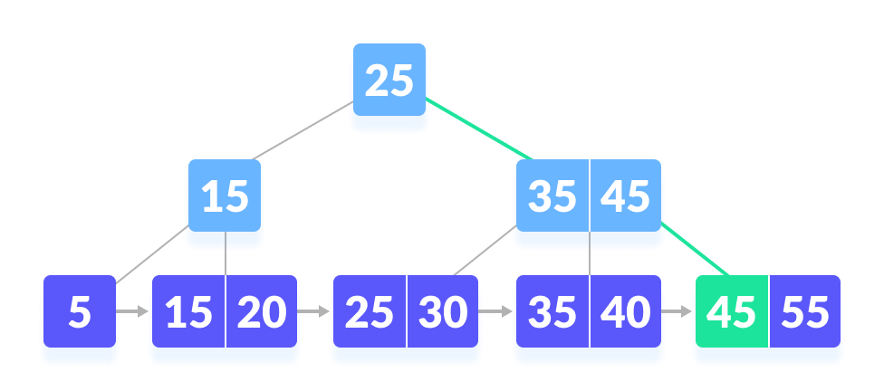
k is found
k is found

Slide 46
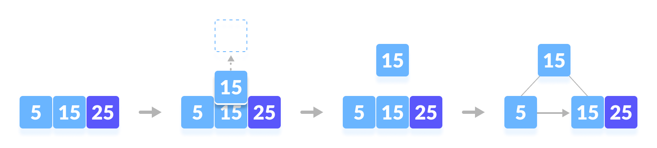
Insertion in B+ tree
Inserting 5, 15 and 25

Slide 47
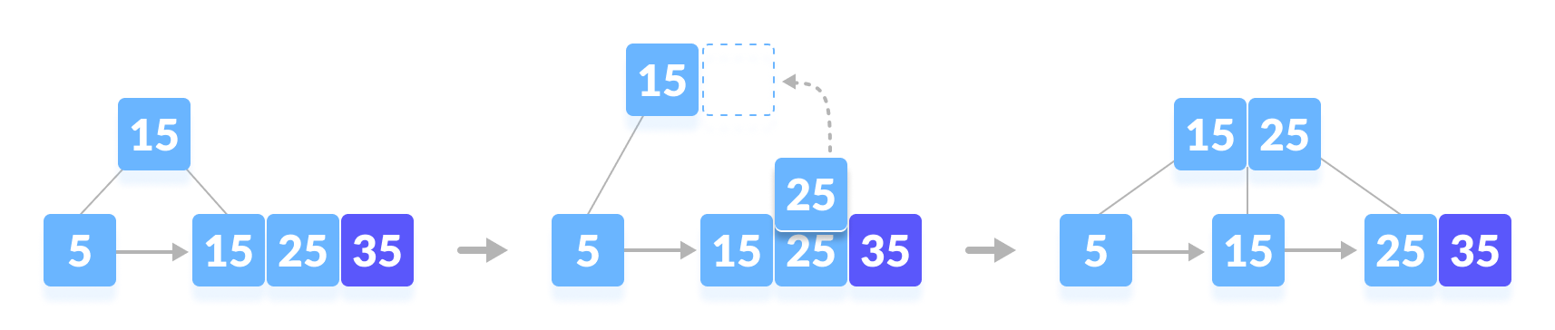
Insertion in B+ tree
Inserting 35

Slide 48
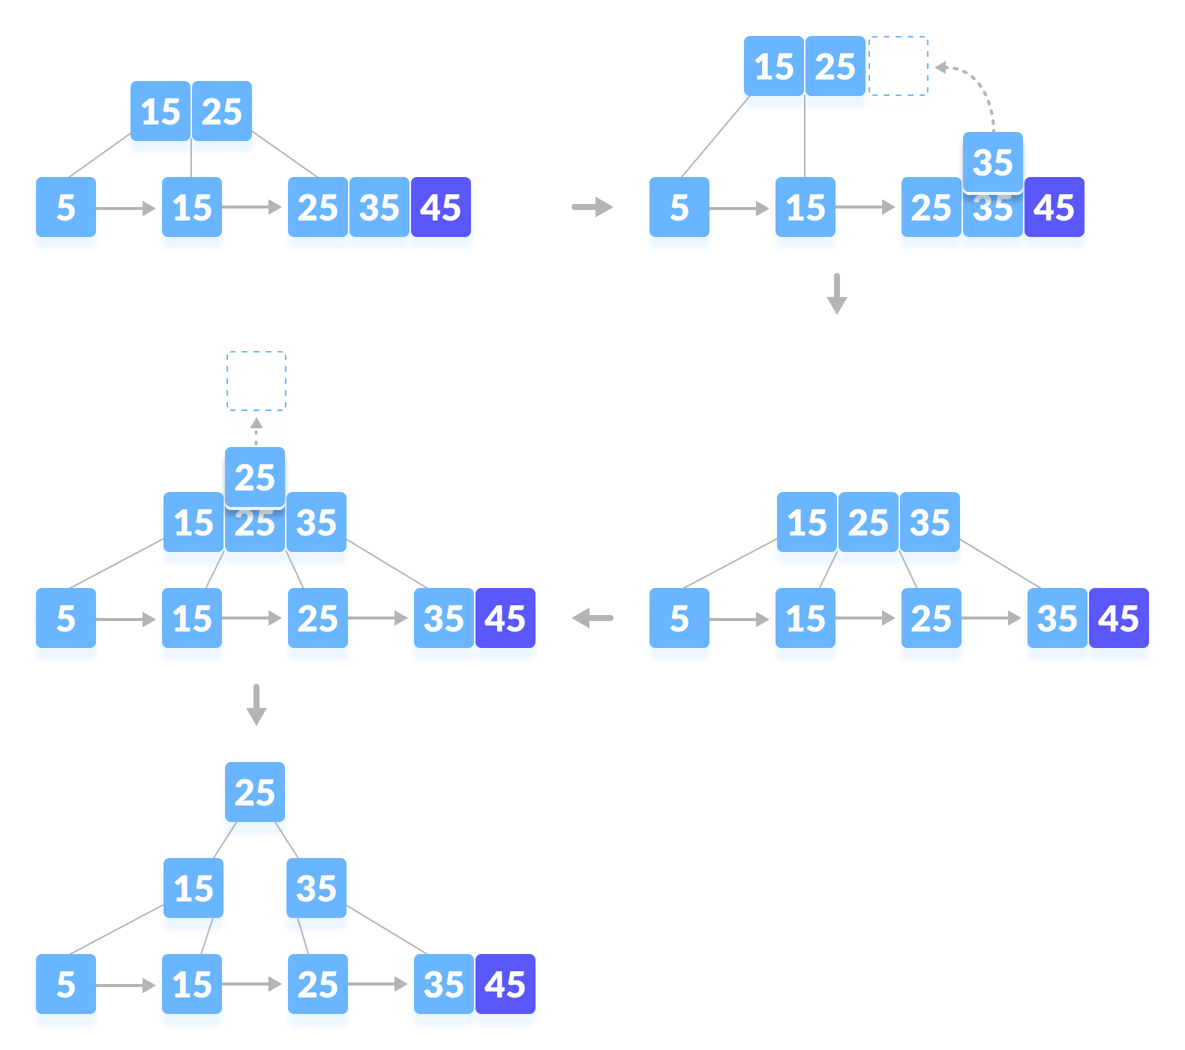
Inserting 45

Slide 49
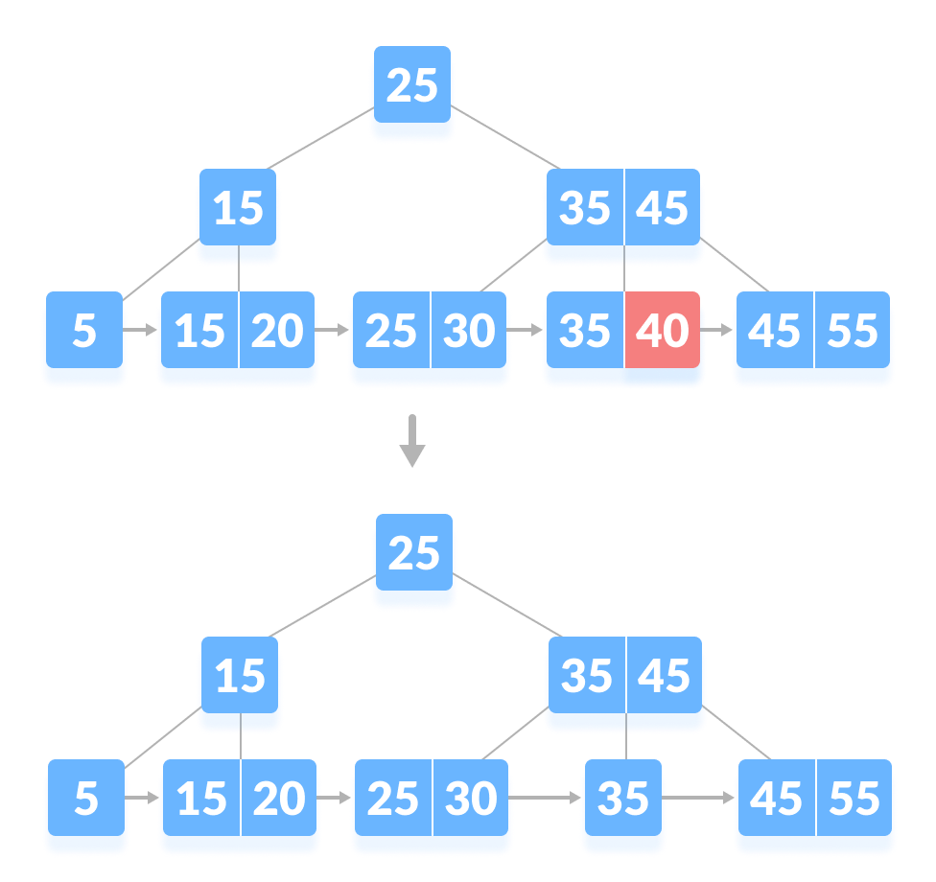
Deleting 40

Slide 50
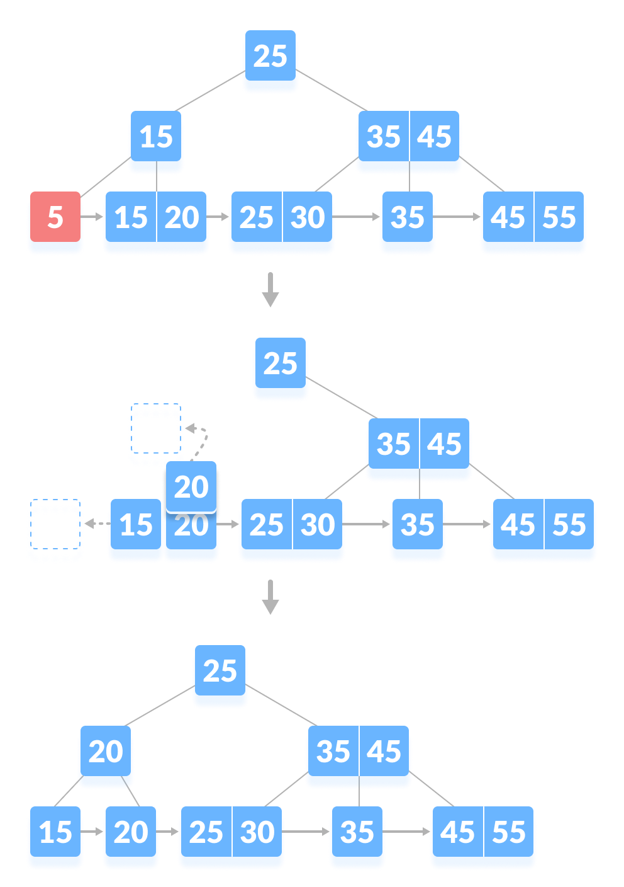
Deleting 5

Slide 51
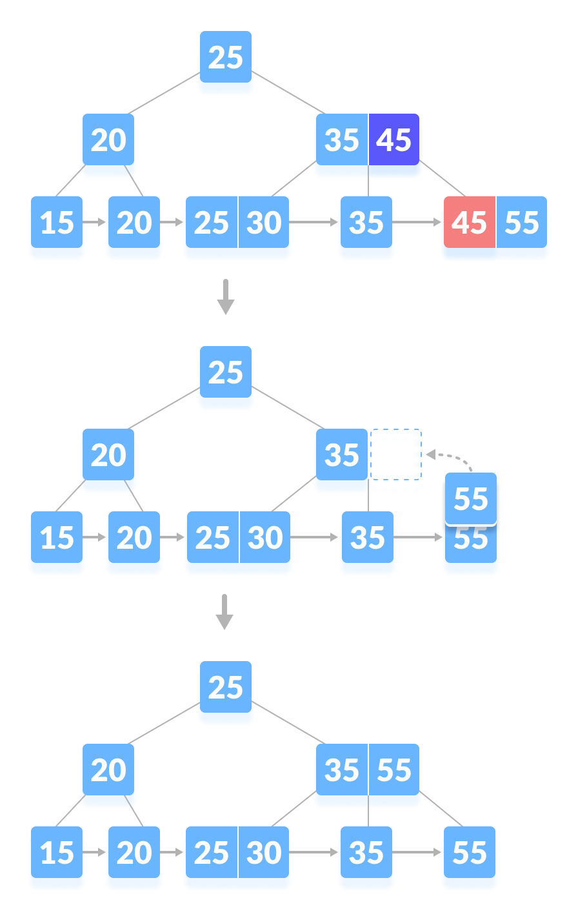
Deleting 45

Slide 52
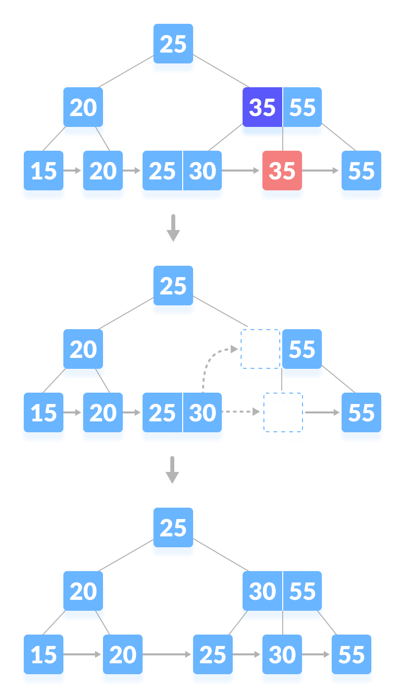
Deleting 35

Slide 53
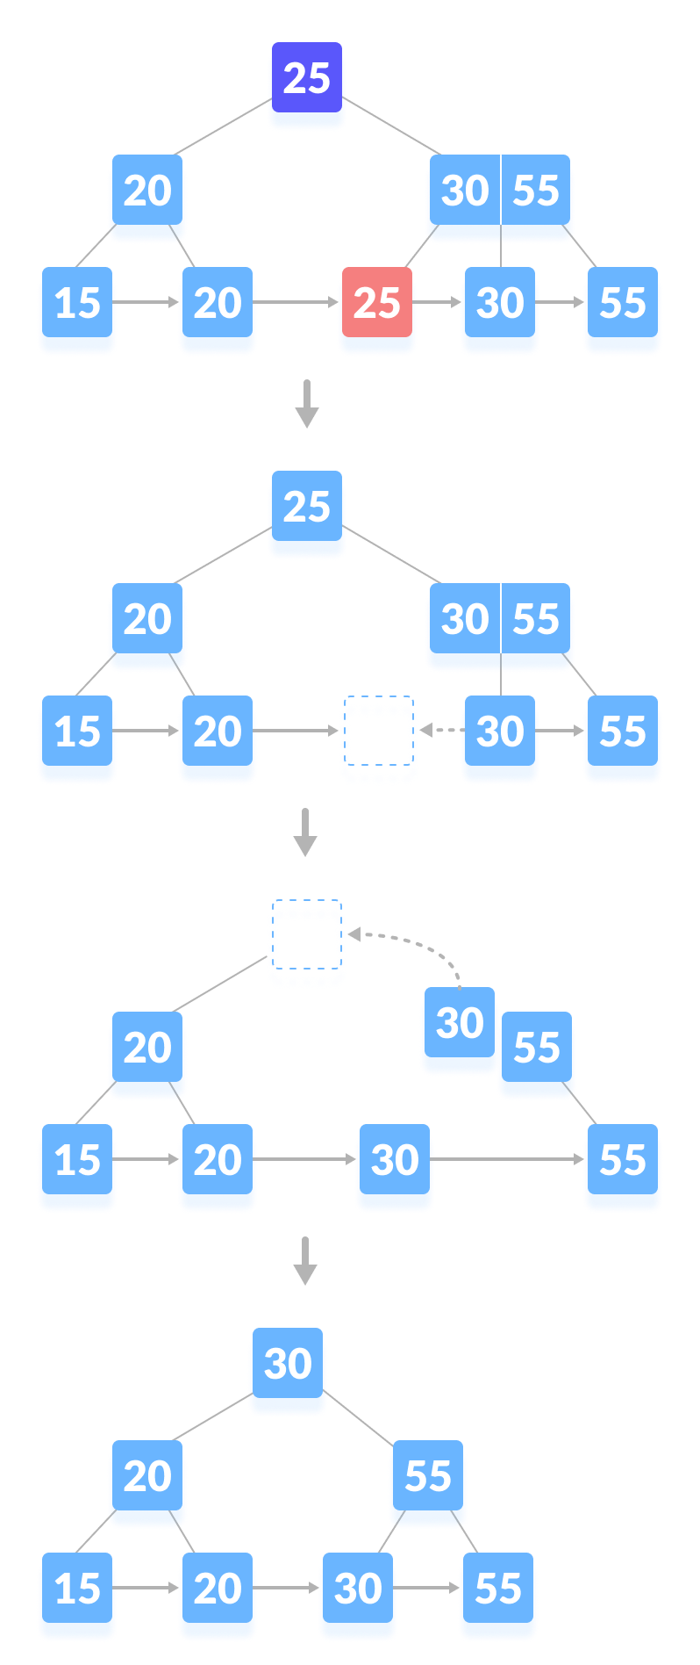
Deleting 25

Slide 54
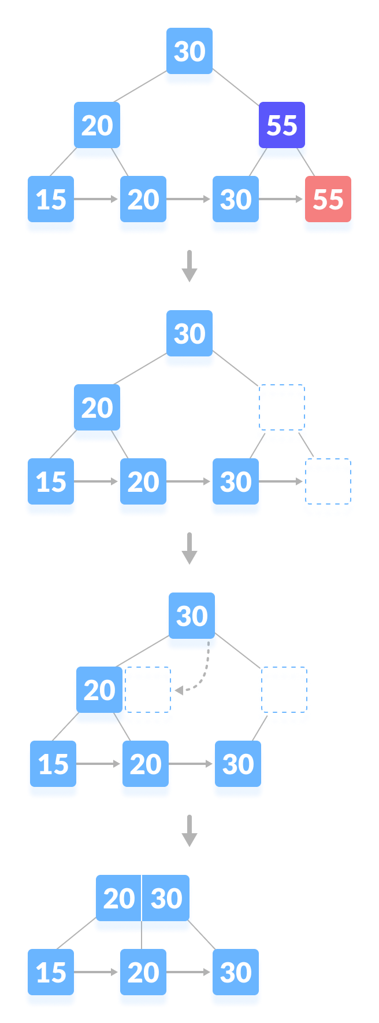
Deleting 55

Slide 55
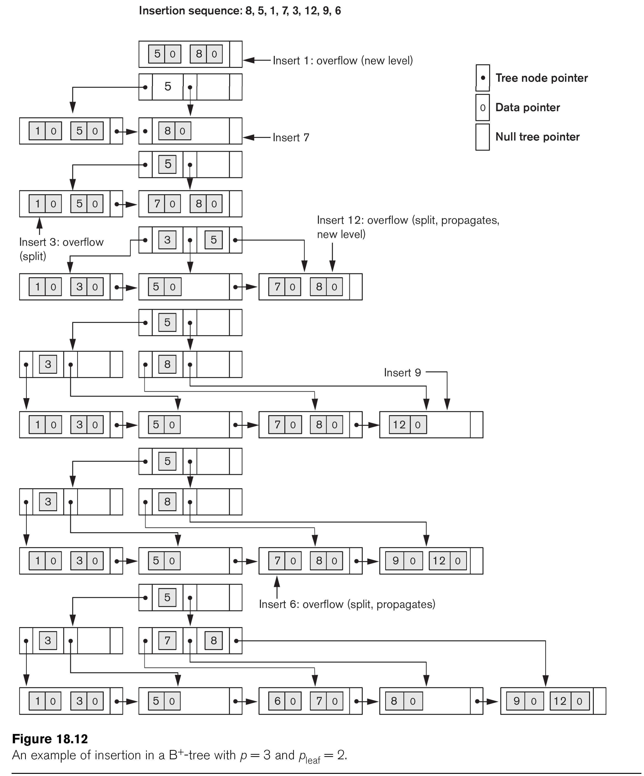
Example of an Insertion in a B+-tree

Slide 56
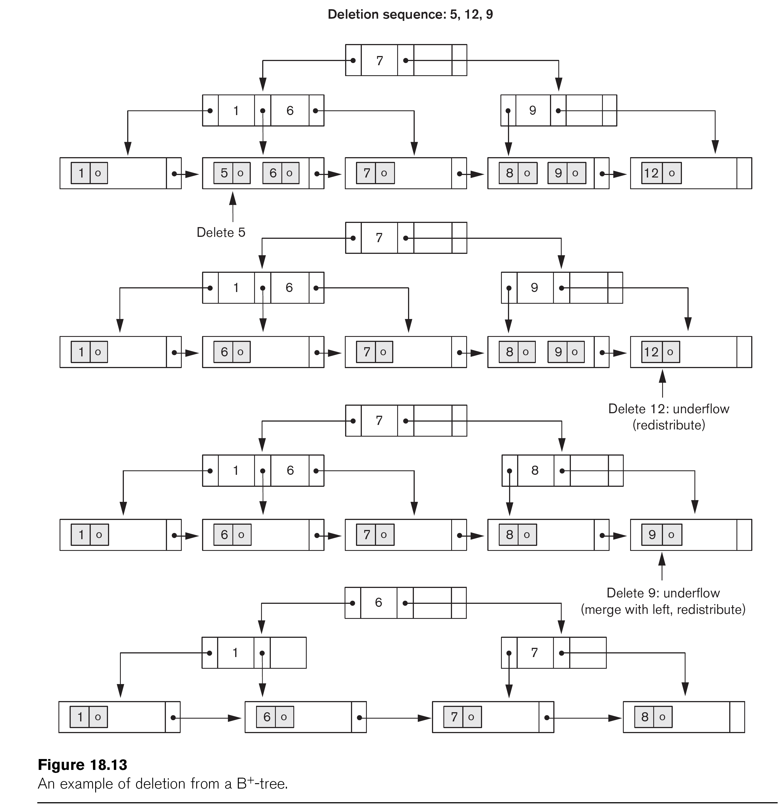
Example of an Deletion in a B+-tree

Slide 57
Problem
Consider a file of 8192 records. Each record is 16 bytes long and its key field is of size 6 bytes. The file is ordered on a key field, and the file organization is unspanned. The file is stored in a file system with block size 512 bytes, and the size of a block pointer is 10 bytes. If the primary index is built on the key field of the file, and a multivalued index scheme is used to store the primary index, Find the number of first level and second level blocks in the multilevel index
No of pointers from 1st level index to data blocks = No of data blocks
as we require only one pointer to each data disk block in case the index is primary and hence ordered index and indexing done on primary key(or) candidate key,else it would be clustering index if it were ordered index on some non key attribute of the relation .
Now , given block size = 512 bytes
Record size = 16 bytes
So , no of records that can be stored in 1 block = 512 / 16
= 32

Slide 58
Given total number of records = 8192
So number of data blocks required = 8192 / 32
= 256
So number of pointers required = 256 as mentioned earlier
Now number of <key,pointer> pair that can
be stored in 1 index block = Block size / [Key size + Pointer size]
= 512 / [6 + 10]
= 32
But we have 256 pointers pointing to records of the database in data blocks
So number of 1st level index blocks required = Total number of pointers / <Key,pointer> pairs that can be stored in 1 index block
= 256 / 32
= 8
Now these 8 disk blocks need to be pointed to by higher level of indexing
Now we have found that one index block can store 32 <key,pointer> pairs but here we need only 8.Each pointer of 2nd level index will point to a 1st level index block.
So number of second level index blocks required = 1

Slide 59
Summary
Types of Single-level Ordered Indexes
Primary Indexes
Clustering Indexes
Secondary Indexes
Multilevel Indexes
Dynamic Multilevel Indexes Using B-Trees and B+-Trees

